Slide 1
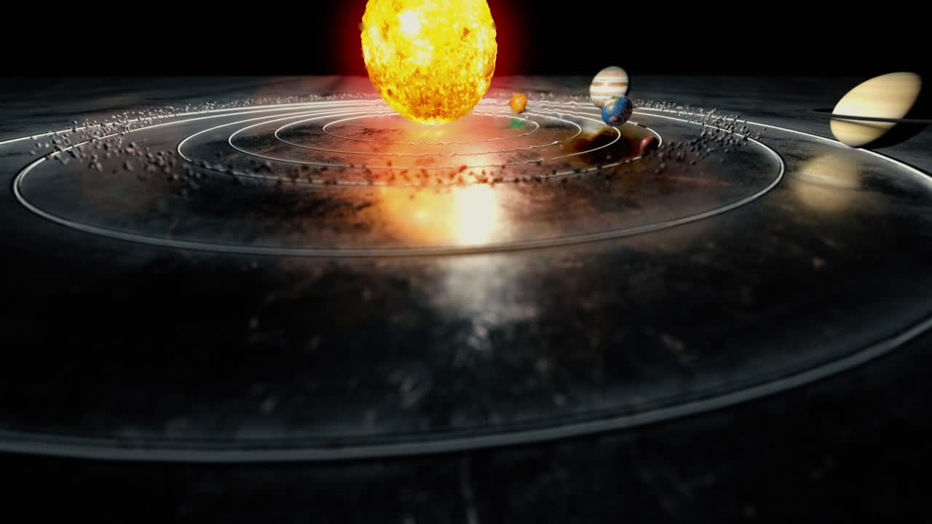

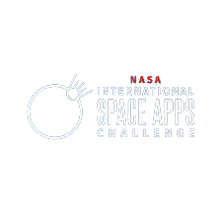
İrem Özdemir
Orhun Yıldırım Öğüt
Sude Naz Şeker
Gülce Ertürk
Çağrı Çiftgül
Ankara / Türkiye

Slide 2
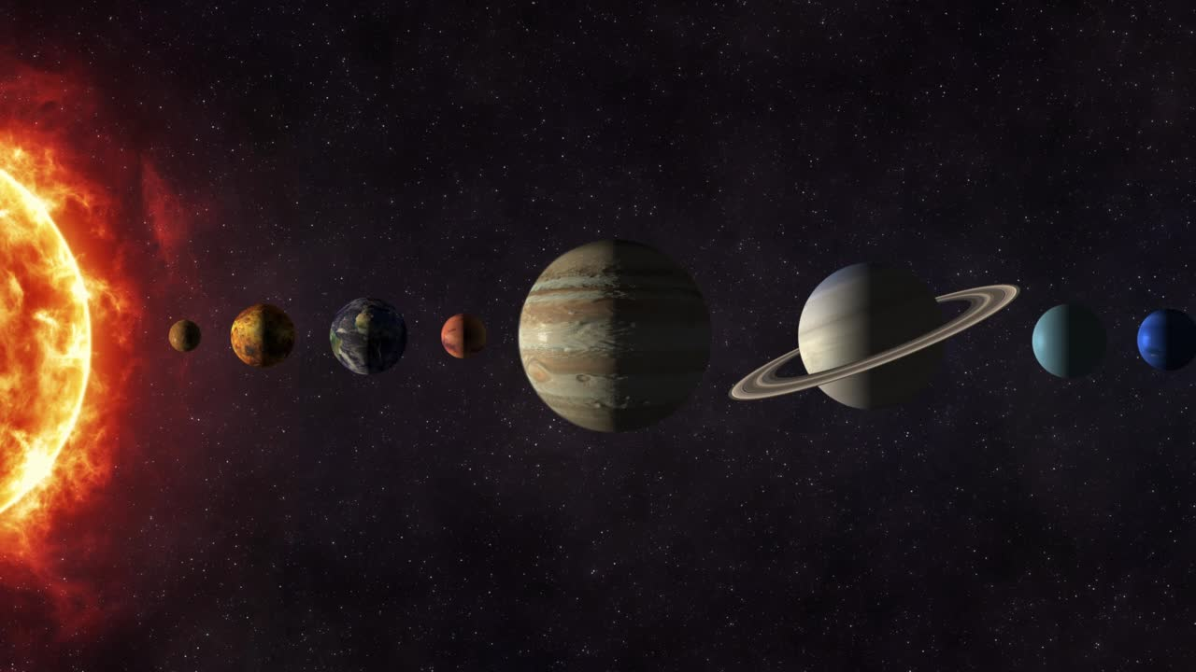
A JOURNEY UNLIKE ANY OTHER
UNCOVER THE MYSTERIES OF THE SOLAR SYSTEM WHILE STAYING ON TOP OF YOUR TASKS! WE’VE COMBINED SPACE EXPLORATION WITH USEFUL TOOLS TO CREATE AN IMMERSIVE EXPERIENCE WHERE LEARNING AND PRODUCTIVITY GO HAND IN HAND.

Slide 3
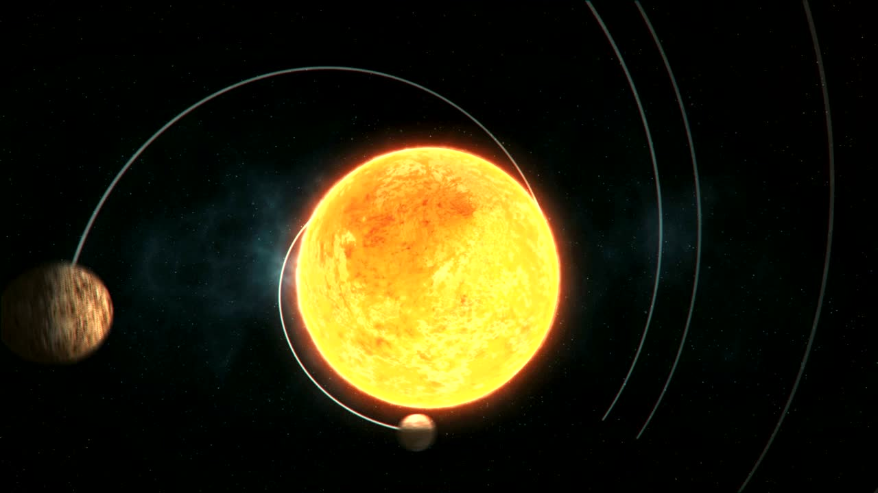
THIS IS SOMETHING DIFFERENT!
We integrated up-to-date scientific data from NASA, ensuring the accuracy of every detail. We created an experience that merges knowledge with productivity, allowing users to learn about space while staying organized.

Slide 4
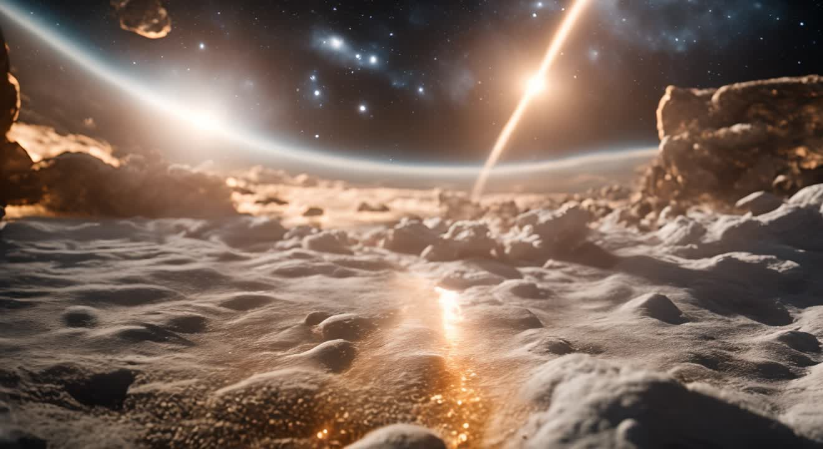
SO, WE MADE IT HAPPEN!
By using accurate data about celestial bodies, we designed an engaging web app that lets users interact with planets, asteroids, and more. It’s not just exploration; it’s a journey through both space and your daily routine.

Slide 5
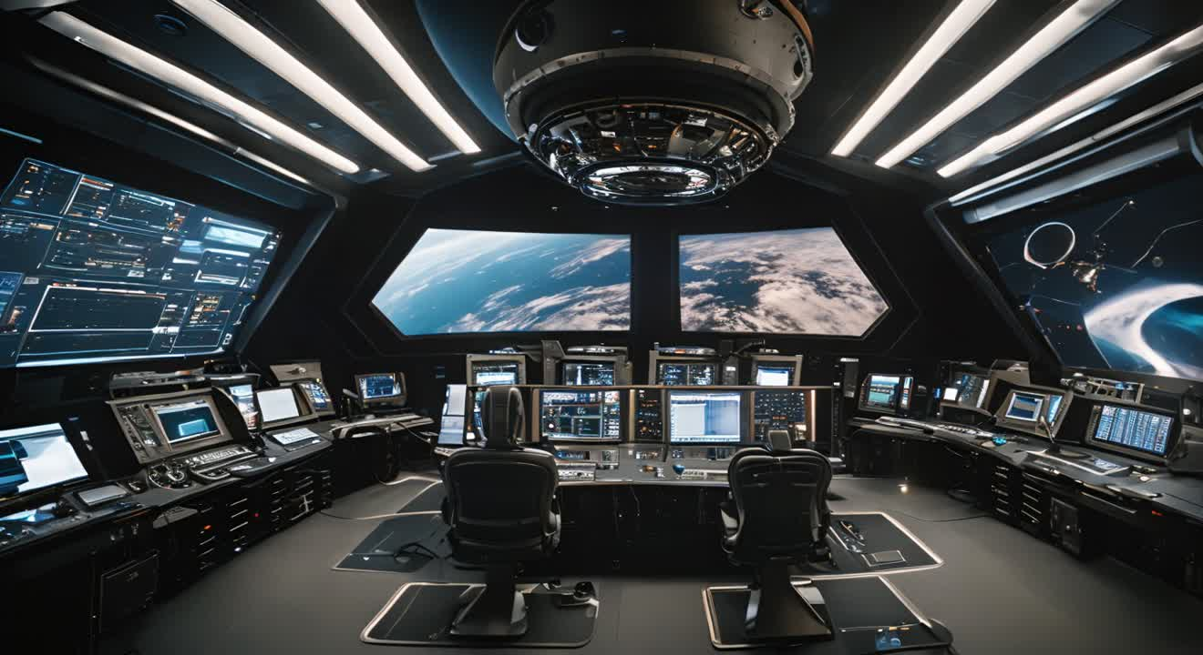
MAKING IT FOR EVERYONE!
Our app isn’t just for fun—it’s a functional tool that merges learning with task management. Thousands of users can explore space while keeping track of their work through a seamless interface.

Slide 6
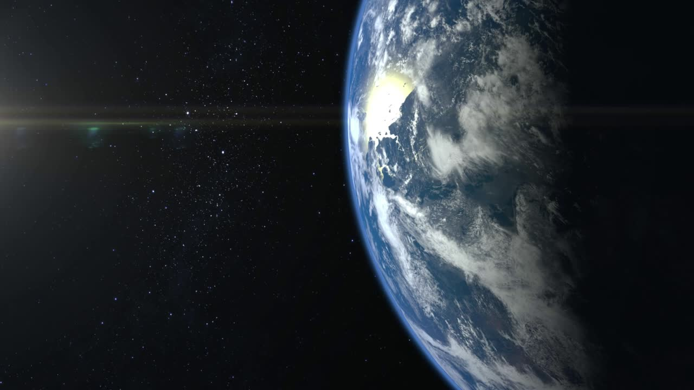
DISCOVER AND EXPERIENCE SOMETHING NEW
Object: Earth
Category: Rocky
Orbital Duration: 365 days
Size: Comparable to Earth
Gravity: Same as Earth
Dive into our app to explore Earth and other planets. Each page provides in-depth information, tools for managing tasks, and more to enhance your daily routine.

Slide 7
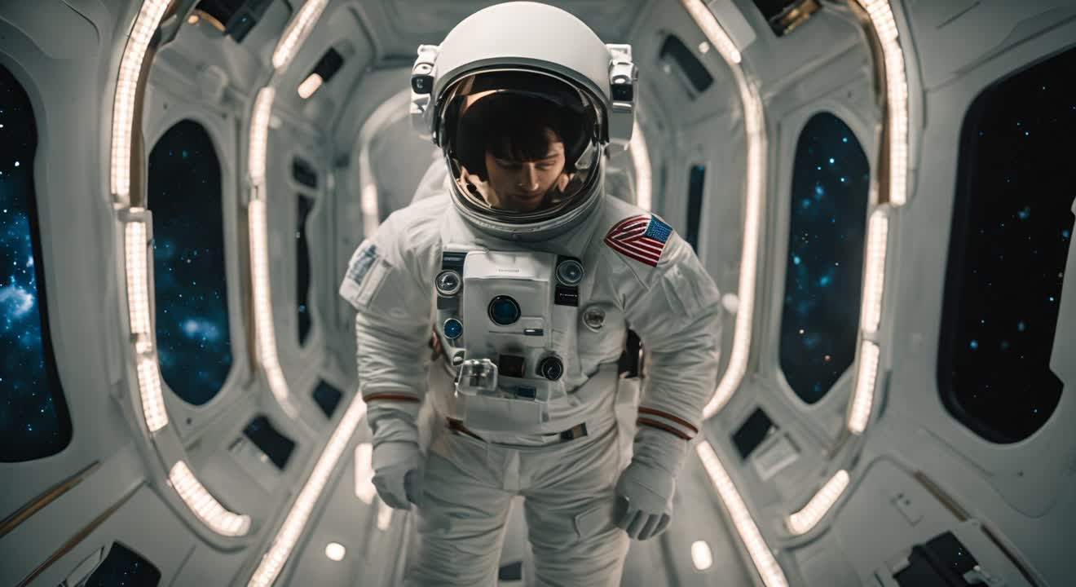


INSIGHTS AND SUMMARY
Our project for the NASA Space Apps Challenge combines space exploration and productivity tools in a unique, interactive web app. Users can explore the Solar System with real NASA data, manage tasks via a built-in calendar, enjoy planet-themed Spotify playlists, and take notes while learning.
The story of Leia ,Laika and B0yl3 AI adds a fun, engaging element, making the app accessible and educational for all ages. Our goal is to inspire curiosity about space while helping users stay productive, blending science and functionality in a simple, user-friendly interface.
SPACE RADIO

